Slide 1
Intro to RenJS
Building Visual Novel Games easily

Slide 2

Who am I?
My name is Vincent, I am a:
Computer Science Major at Brooklyn College graduating this Fall 2020
Active Hacker (Very active)
  I lowkey have a problem

Slide 3
What is RenJS?
RenJS is a video game engine for making Visual Novels that run directly in the web browser. Based on Ren'Py and powered by PhaserJS, it's easy to use and easy to extend.
Knowledge of JavaScript is not needed!!

Slide 4
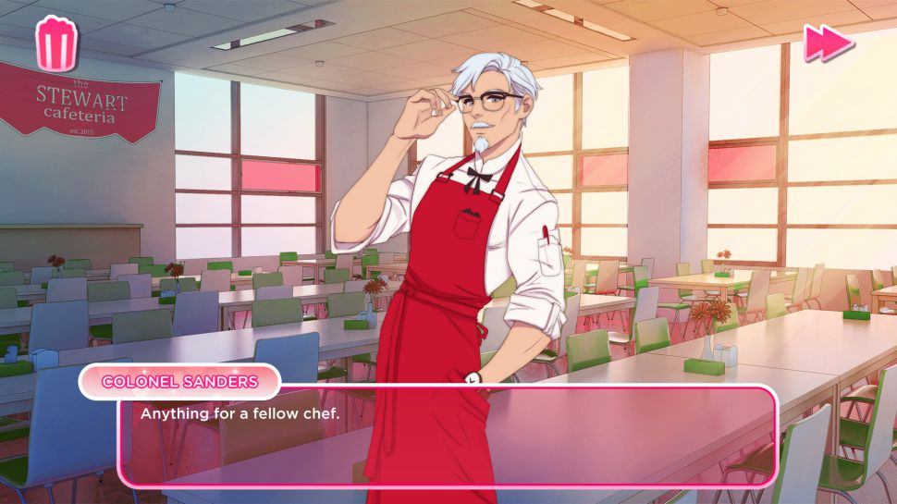
A visual novel is an interactive game genre, which originated in Japan, featuring text-based story with narrative style of literature and interactivity aided by static or sprite-based visuals, most often using anime-style art or occasionally live-action stills (and sometimes video footage)

Slide 5
Setup

Slide 6




TEXT Editor
Notepad++
(Windows only)
Sublime Text (Cross Platform)
Atom
(Cross Platform)
VS Code
(Cross Platform)

Slide 7
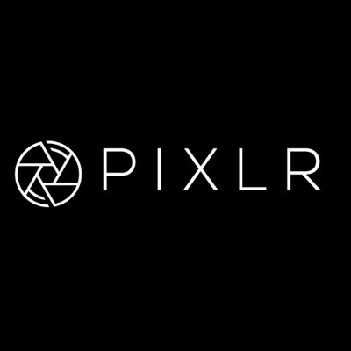

Photo Editor
Paint.net (Windows only)
Pixlr
https://pixlr.com/x/

Slide 8


Music/sound
Bensound
Creative Commons

Slide 9

Browser
FireFox

Slide 10
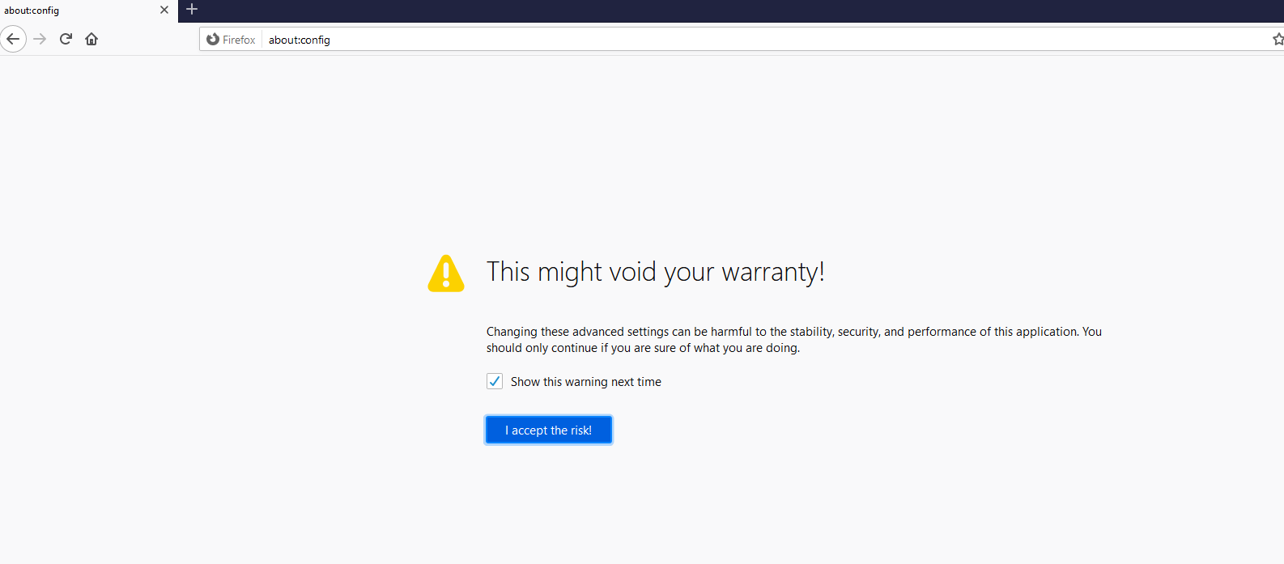
Configuration is needed
Go to the address bar and type: about:config

Slide 11
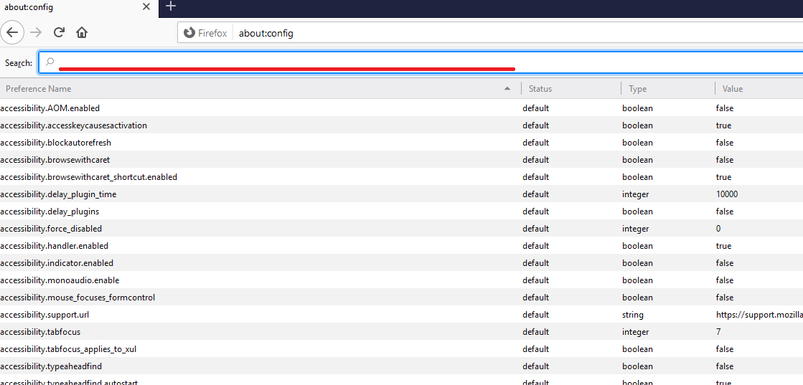
In this bar type: privacy.file_unique_origin

Slide 12
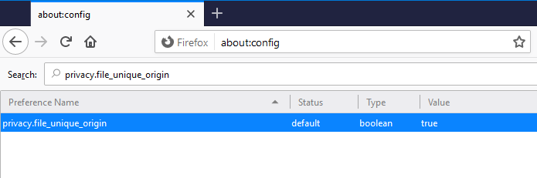
Double click to turn the value to: false

Slide 13
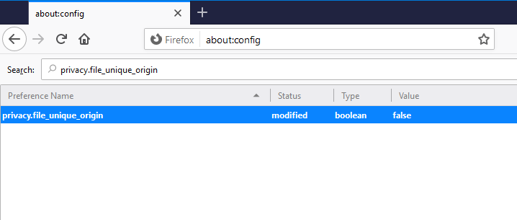

Slide 14
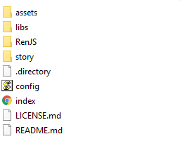
Getting familiar with your setup

Slide 15
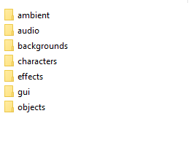
Assets folder
This is the location where you will store:
Characters
Backgrounds
Music/sound

Slide 16

Story Folder
This is where the magic happens, this is the location where you configure:
Character settings
Scripting your story

Slide 17
What is YAML?
YAML is a human-readable data-serialization language. It is commonly used for configuration files and in applications where data is being stored or transmitted.

Slide 18
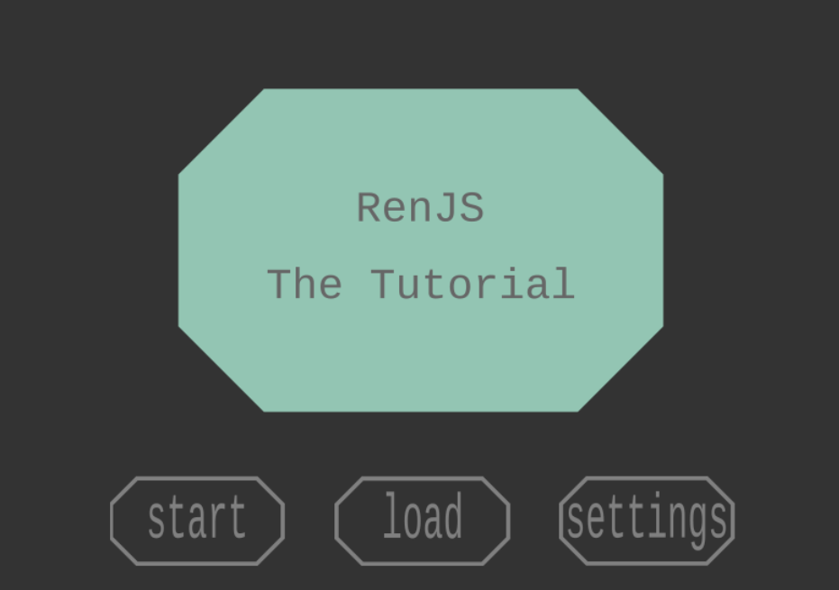
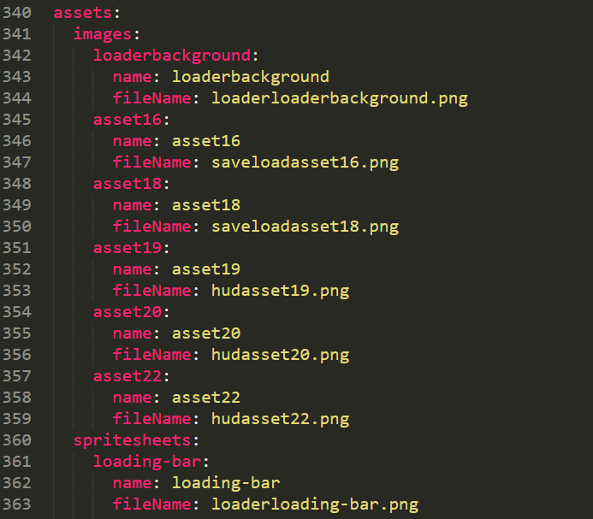
GUI.yaml

Slide 19
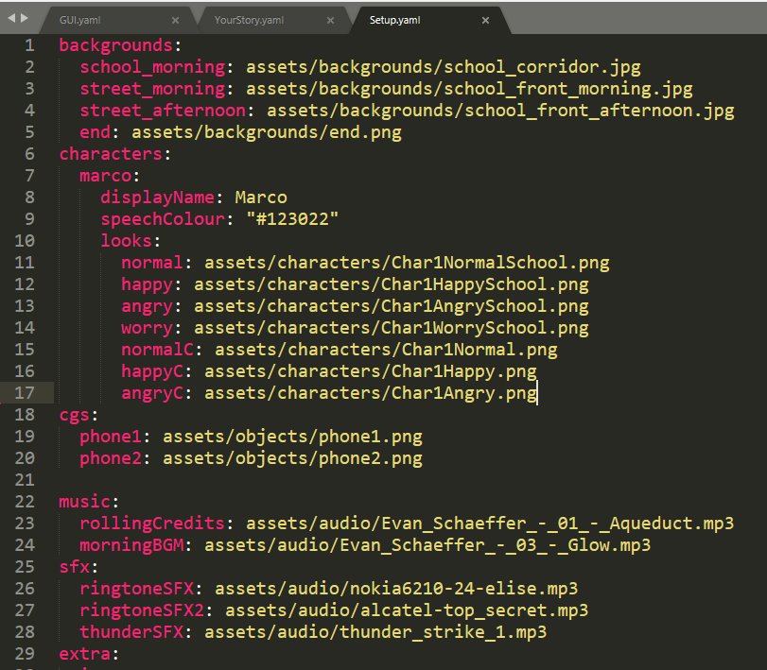
Setup.yaml
This is where you will be labeling:
Custom sounds
Custom sprites
  Text color
  https://htmlcolorcodes.com/

Slide 20
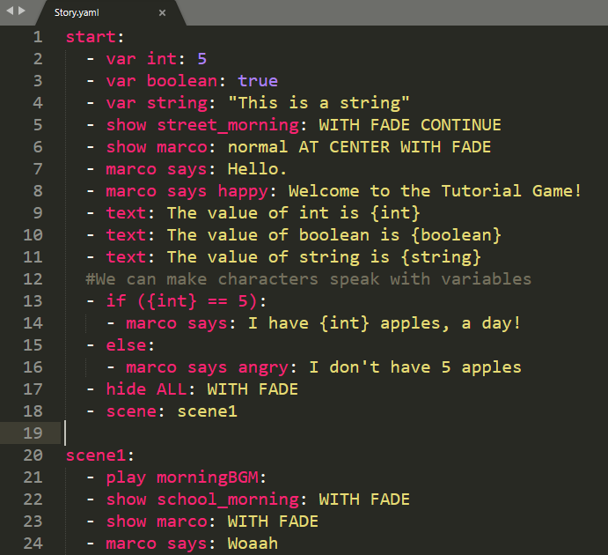
Story.yaml

Slide 21
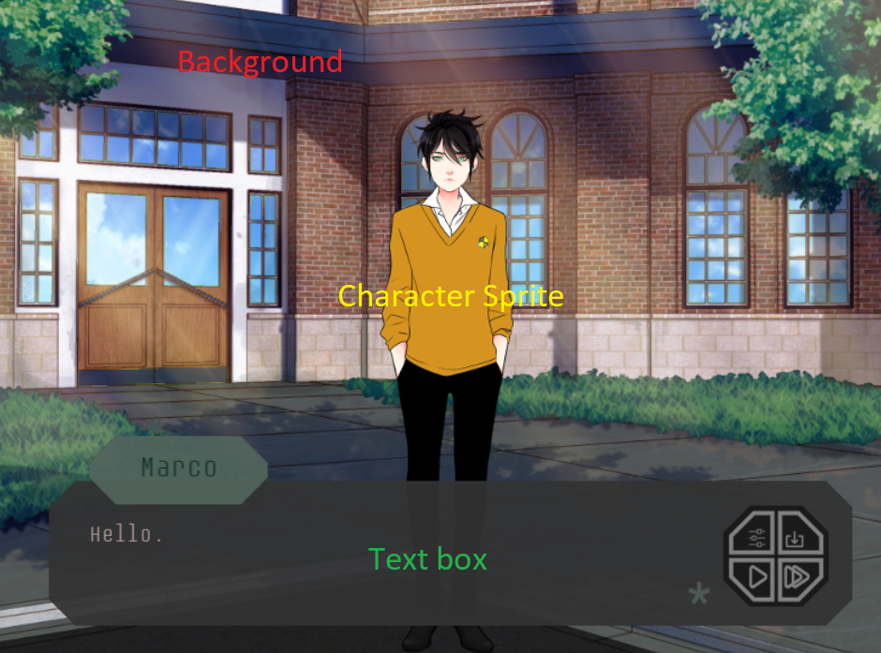
Scene

Slide 22

Declaring variables

Slide 23

Printing out the values

Slide 24
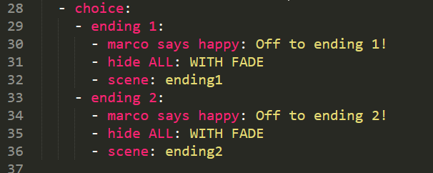
Choices and Branching

Slide 25
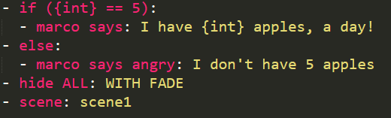
Conditions

